Slide 1



Crestron PinPoint™
The first personal productivity app for employees, PinPoint clears a path for you to work smarter, faster, and more efficiently.

Slide 2





Crestron PinPoint™
Proximity room booking
Advanced room search
Room preview & wayfinding
User experience & automation
“My Day” dashboard
Notes:
Proximity Room Booking
Locate available rooms nearby at all times. While you’re in a meeting, schedule the next one, rather than wait until you return to your desk.
Advanced Room Search
Using contextual filters, find rooms that have the seating capacity and capabilities you need for your meeting – a video conferencing room that seats 12, for example.
Room Preview & Wayfinding
Get info on rooms that you could never get before, including location in the floor plan, photos of the inside and outside, and room type, size, and features/capabilities.
User Experience & Automation
See a personalized welcome message on the display confirming you’re in the right room. Enter the room and instantly present wirelessly from your mobile device, at the touch of a button.
"My Day" Dashboard
View your daily schedule including number of meetings and total hours committed to meetings. Receive a “Conflict Notice” when you’re double-booked, and a “Back-to-Back Notice” when you schedule one meeting immediately after another. View a real-time countdown of your current meeting and countdown to your next meeting.

Slide 3

Proximity Room Booking
Greatly reduces time and frustration of finding a nearby space to meet

Slide 4
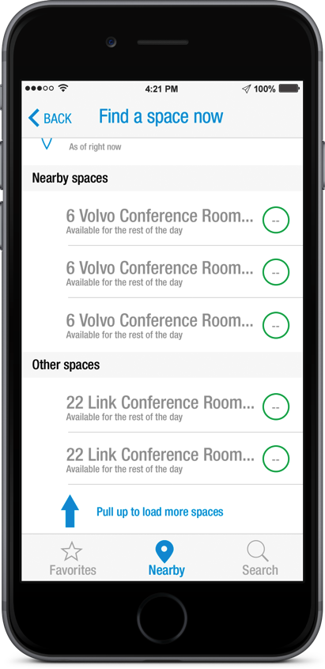
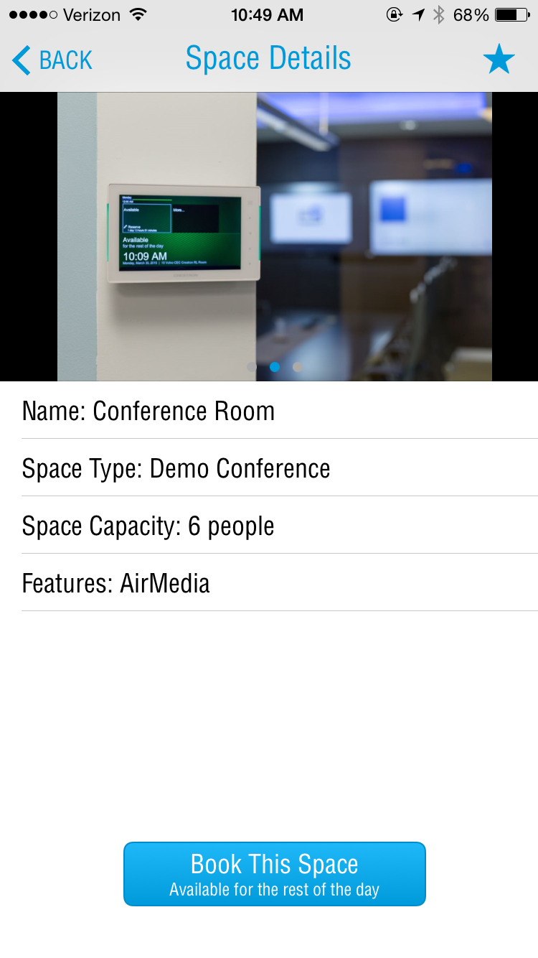


Proximity Room Booking
Find a Space
Book a Space

Slide 5
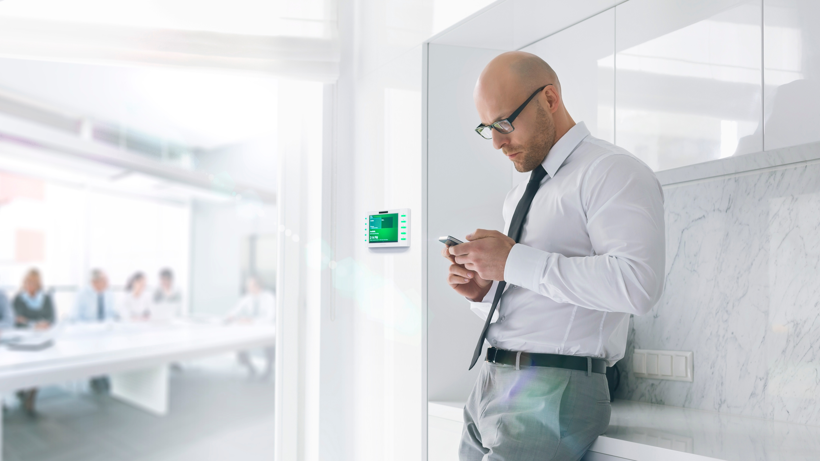

Advanced Room Search
Find the right room for your meeting

Slide 6
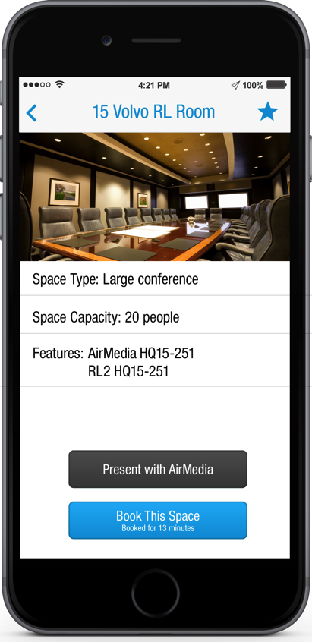
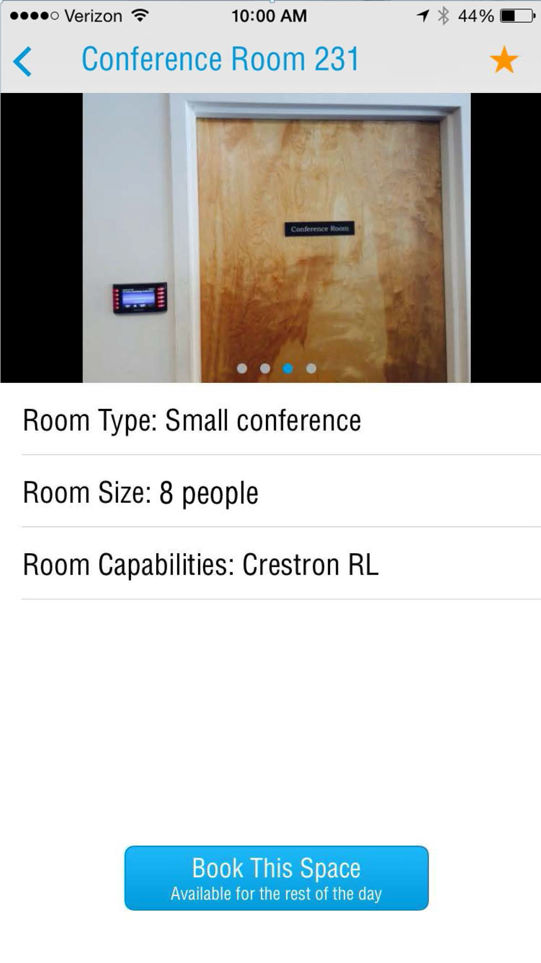

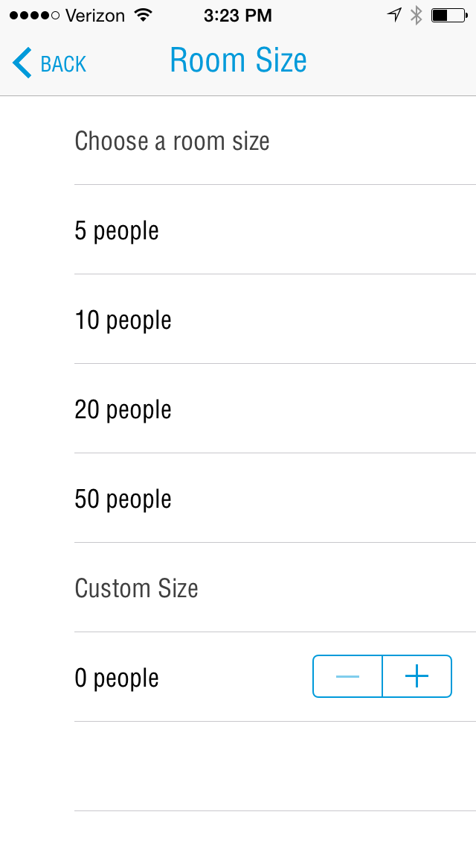
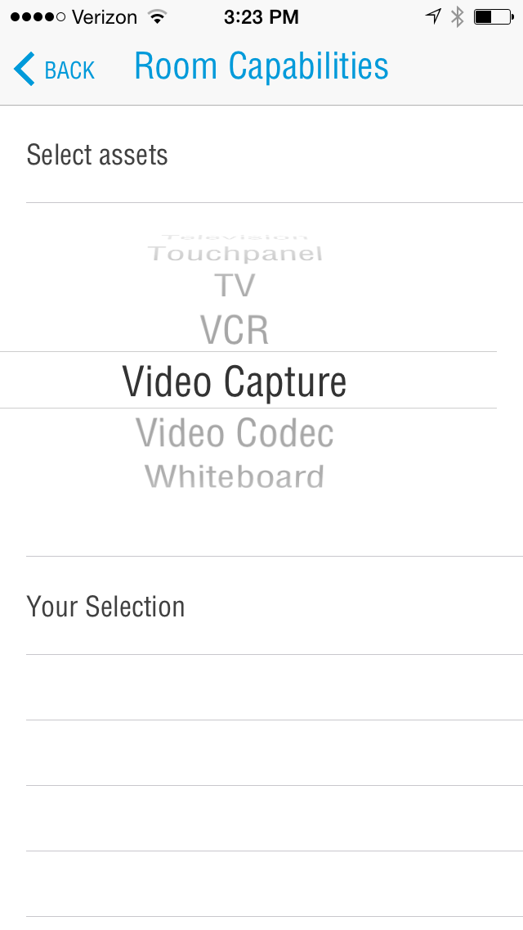



Advanced Room Search
Search Criteria
Favorites
Tagged Content
Notes:
Use contextual filters to find the right room with the right tools for your meeting, wherever you are, e.g. a videoconference room for ten people, or a huddle room for four with wireless presentation capabilities
Quickly view "Favorites" and perform tagged searches
"Tagging" enables you to save criteria from previous room searches for recurring meeting types

Slide 7

Room Preview & Wayfinding
See the space and where it’s located before you get there

Slide 8
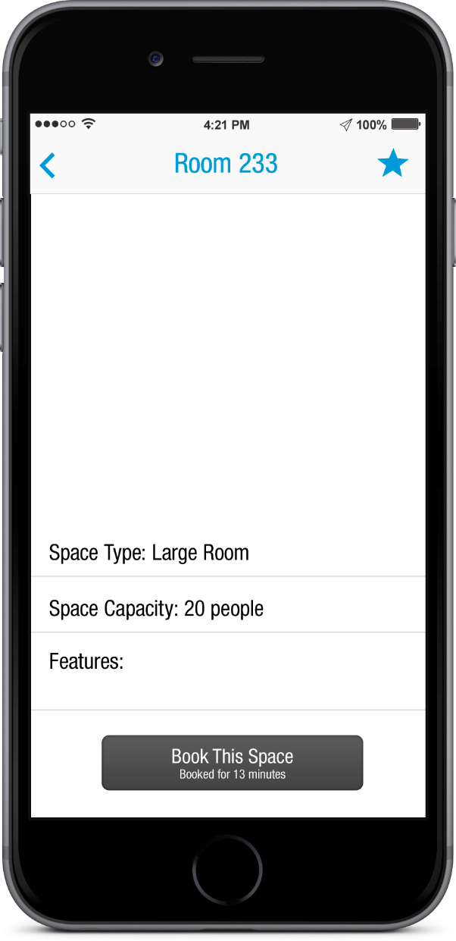
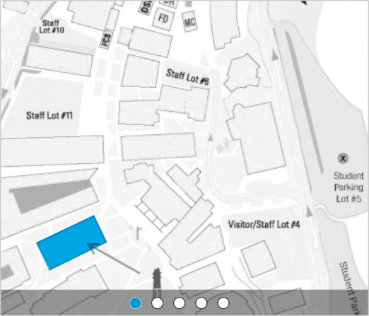
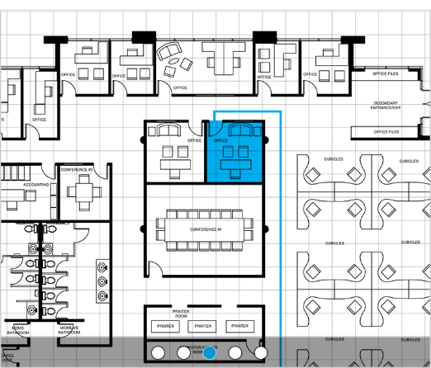
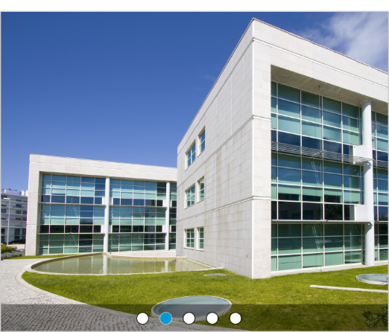

Room Preview & Wayfinding
Location
Notes:
Get information about rooms that helps you prepare and find your next meeting. No more surprises.
Location of room in floor plan – no more wondering the halls looking for your meeting
Photos of the from the hallway – visual reference of what you’re looking for
Photos of the interior of the room – visualize the layout of the room and confirm it’s a suitable space for you and your guests
Room type, size, and features/capabilities – confirm it’s the right size and has the technology to support your meeting

Slide 9
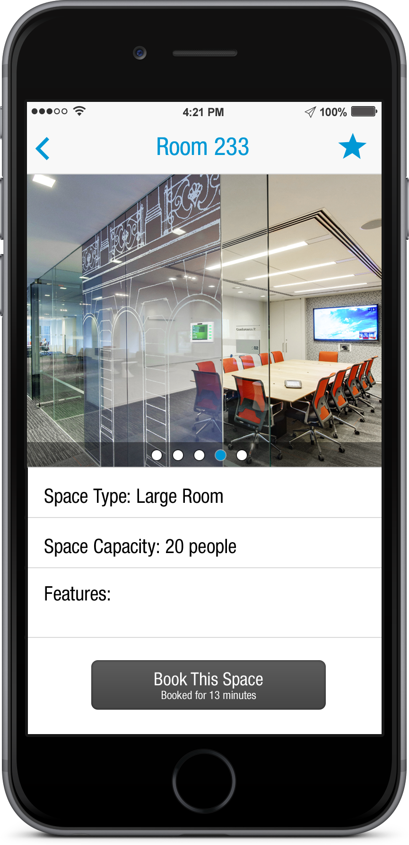
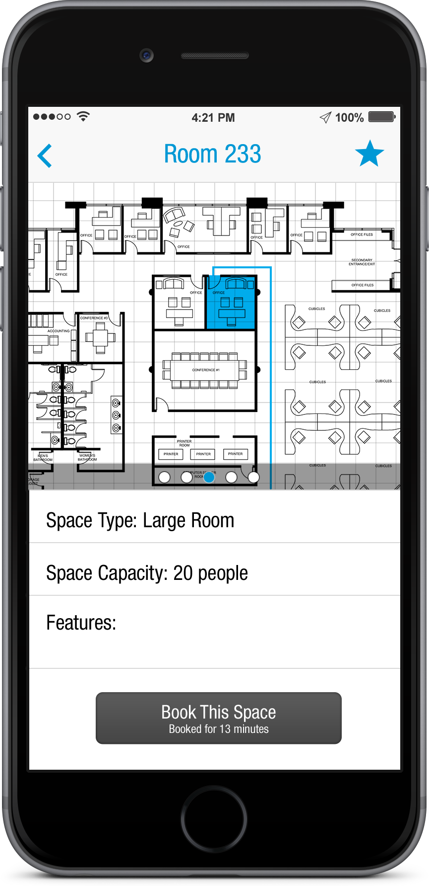
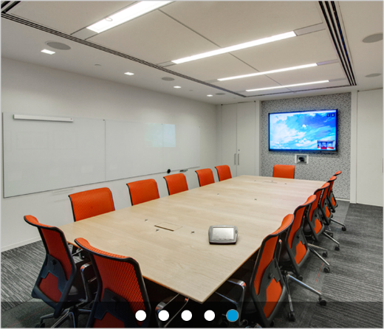
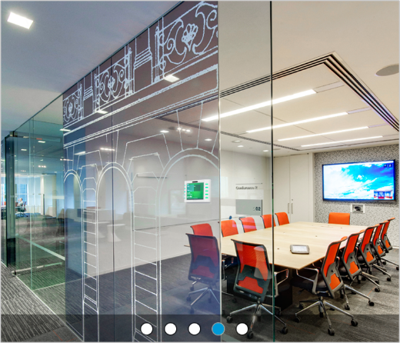

Room Preview & Wayfinding
Location
Room Photo Gallery
Notes:
Get information about rooms that helps you prepare and find your next meeting. No more surprises.
Location of room in floor plan – no more wandering the halls looking for your meeting
Photos of the from the hallway – visual reference of what you’re looking for
Photos of the interior of the room – visualize the layout of the room and confirm it’s a suitable space for you and your guests
Room type, size, and features/capabilities – confirm it’s the right size and has the technology to support your meeting

Slide 10
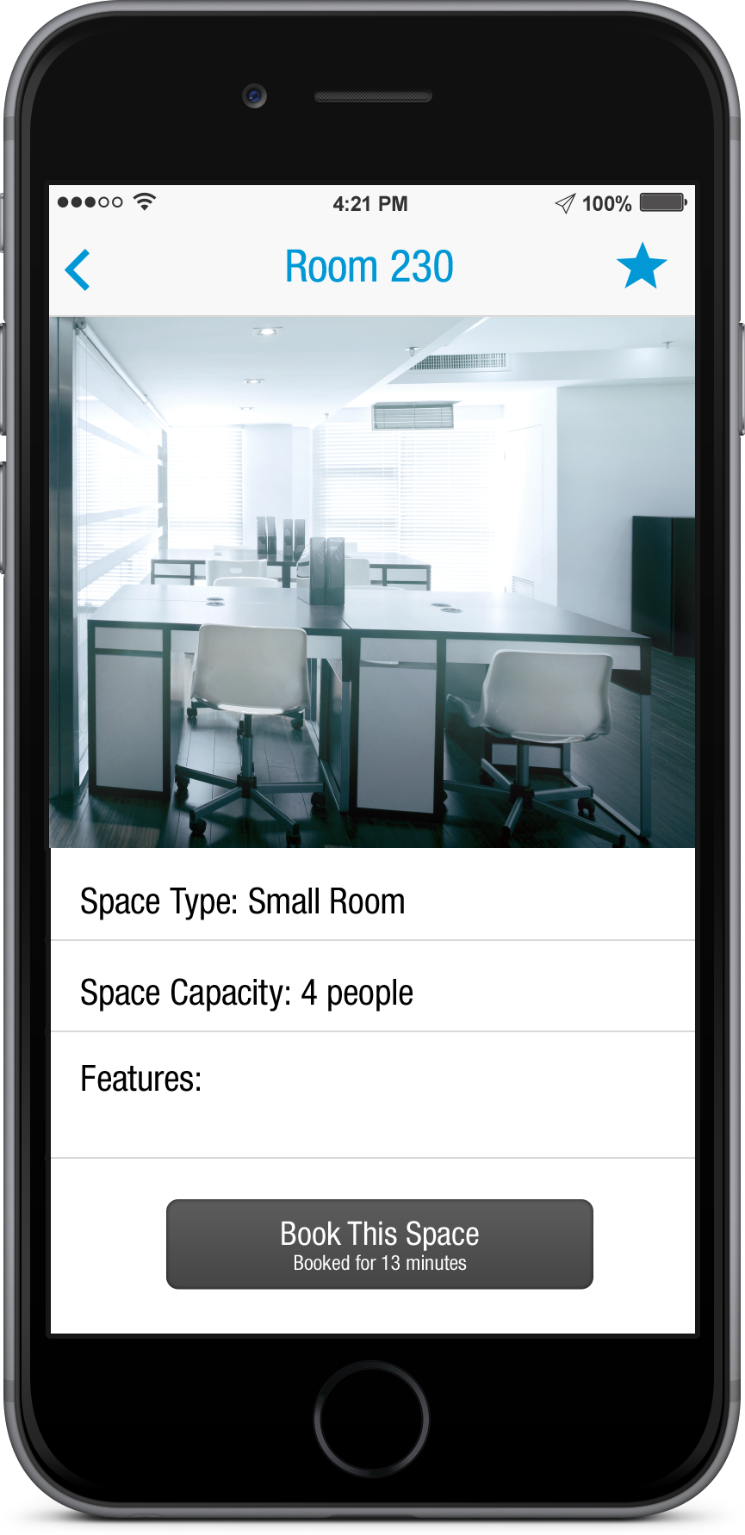
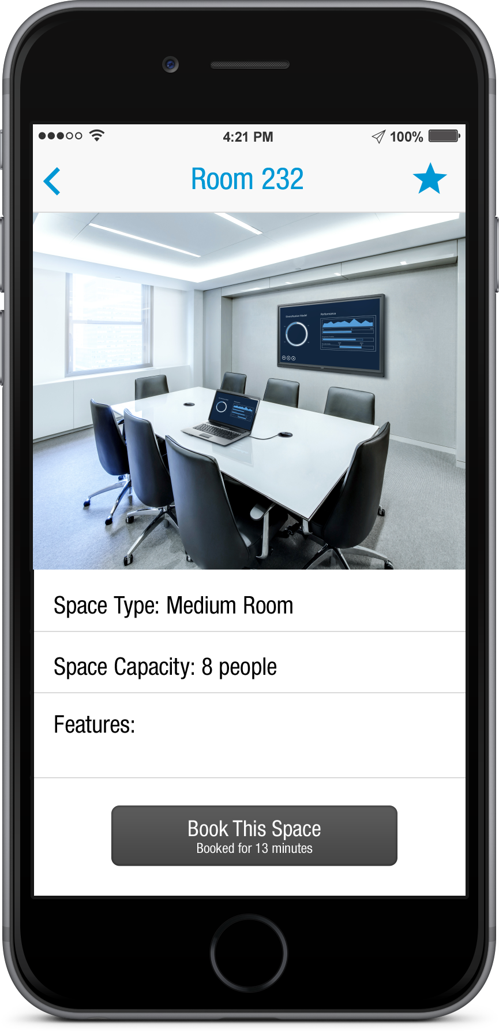

Room Preview & Wayfinding
Location
Room Photo Gallery
Room Size & Capabilities
Notes:
Get information about rooms that helps you prepare and find your next meeting. No more surprises.
Location of room in floor plan – no more wondering the halls looking for your meeting
Photos of the from the hallway – visual reference of what you’re looking for
Photos of the interior of the room – visualize the layout of the room and confirm it’s a suitable space for you and your guests
Room type, size, and features/capabilities – confirm it’s the right size and has the technology to support your meeting

Slide 11


User Experience & Automation
An intelligent meeting space that provides a personalized, intuitive user experience

Slide 12
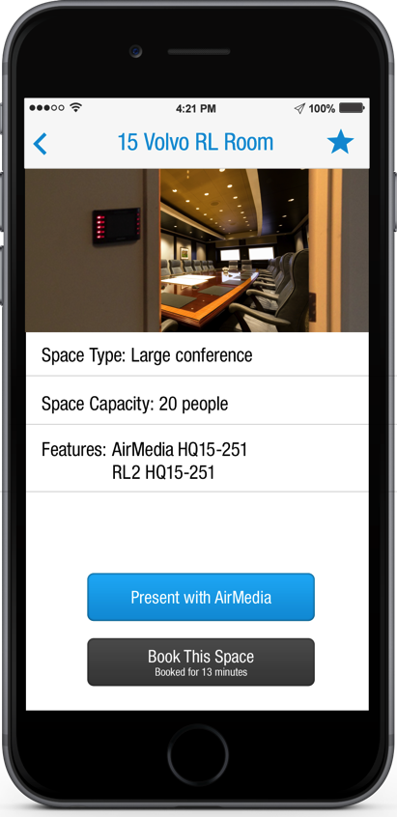
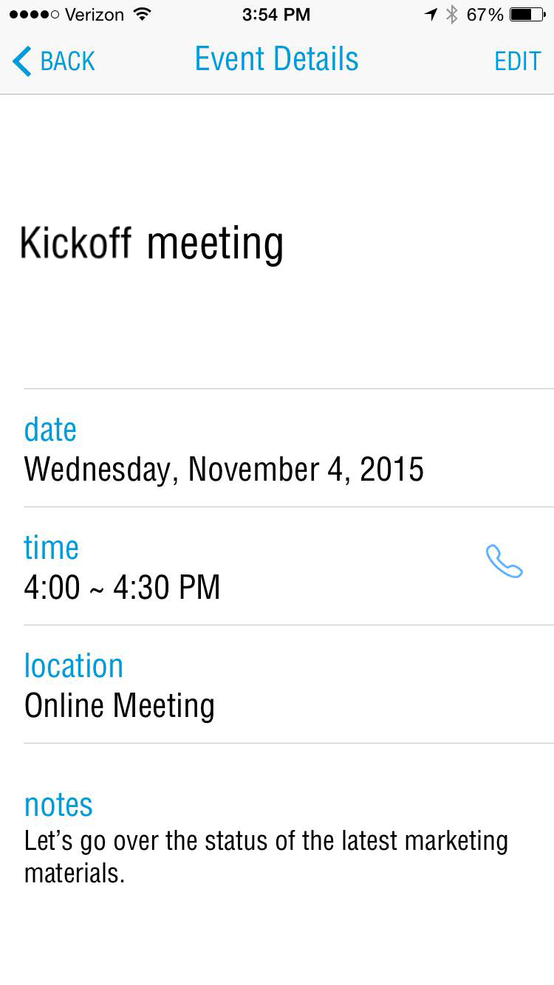



User Experience & Automation
Welcome Message
Instant Content Sharing
One-Touch Dial-In
Notes:
See a personalized welcome message confirming you're in the right room
Enter the room and instantly share content from your mobile device on the room display
When you leave, the room knows it’s vacant, and everything automatically turns off

Slide 13

“My Day” Dashboard
Anticipate potential obstacles throughout your day so everything runs smoothly

Slide 14

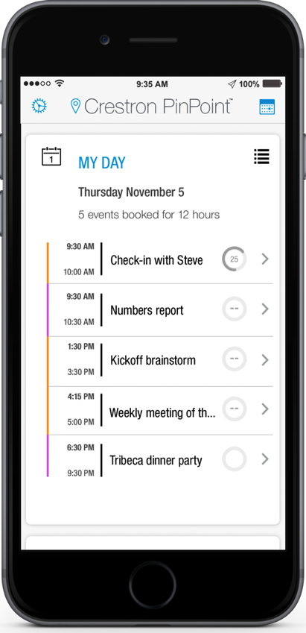
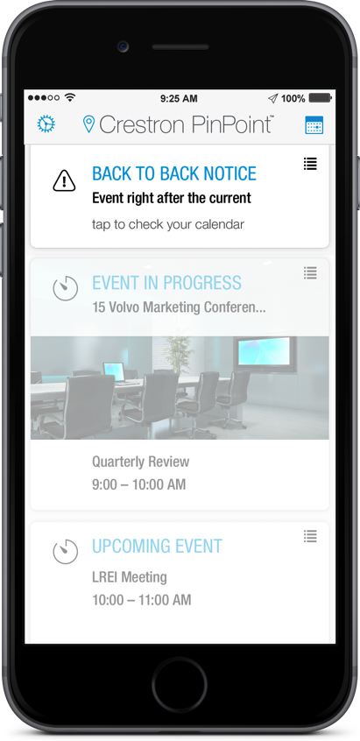
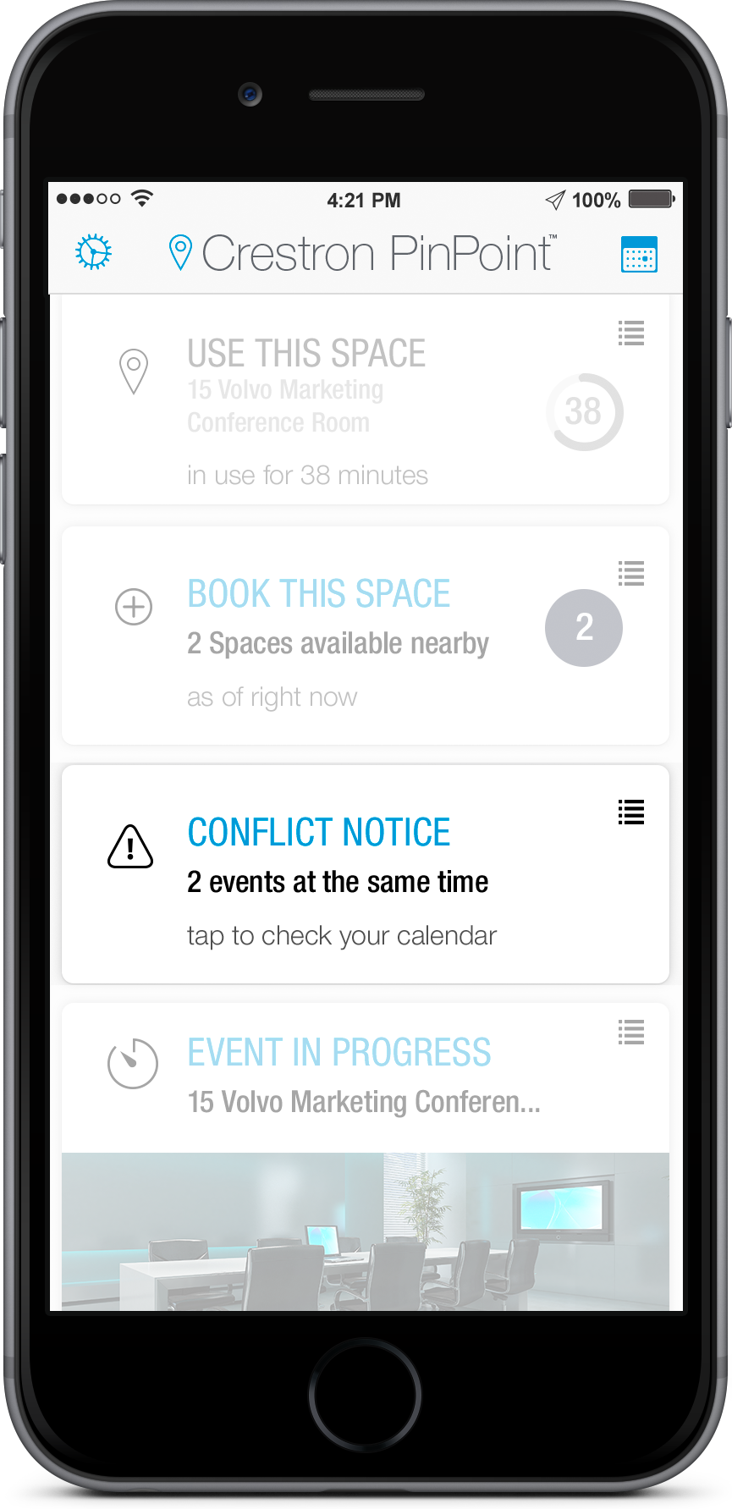

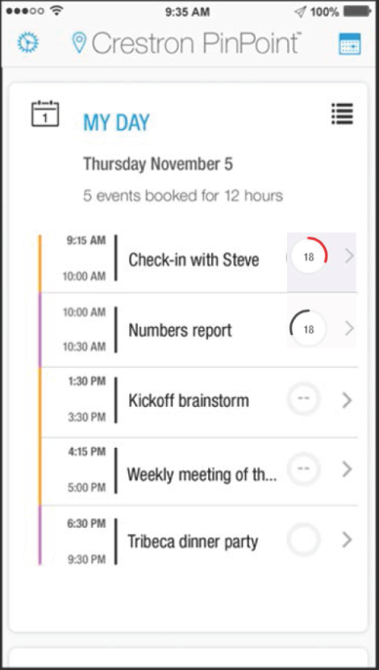
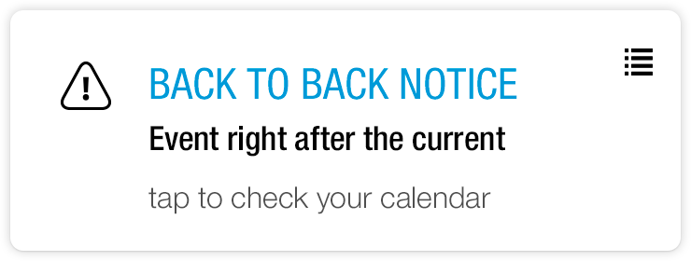


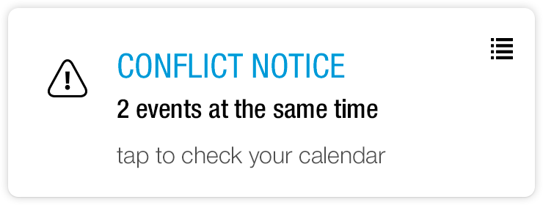

“My Day” Dashboard
View Schedule
Countdowns
Back-to-Back Notice
Conflict Notice
Notes:
View your daily schedule including number of meetings and total hours committed to meetings
Receive a "Conflict Notice" when you’re double-booked
Receive a "Back-to-Back Notice" when you schedule one meeting immediately after another
View a real-time countdown of your current meeting and countdown to your next meeting

Slide 15
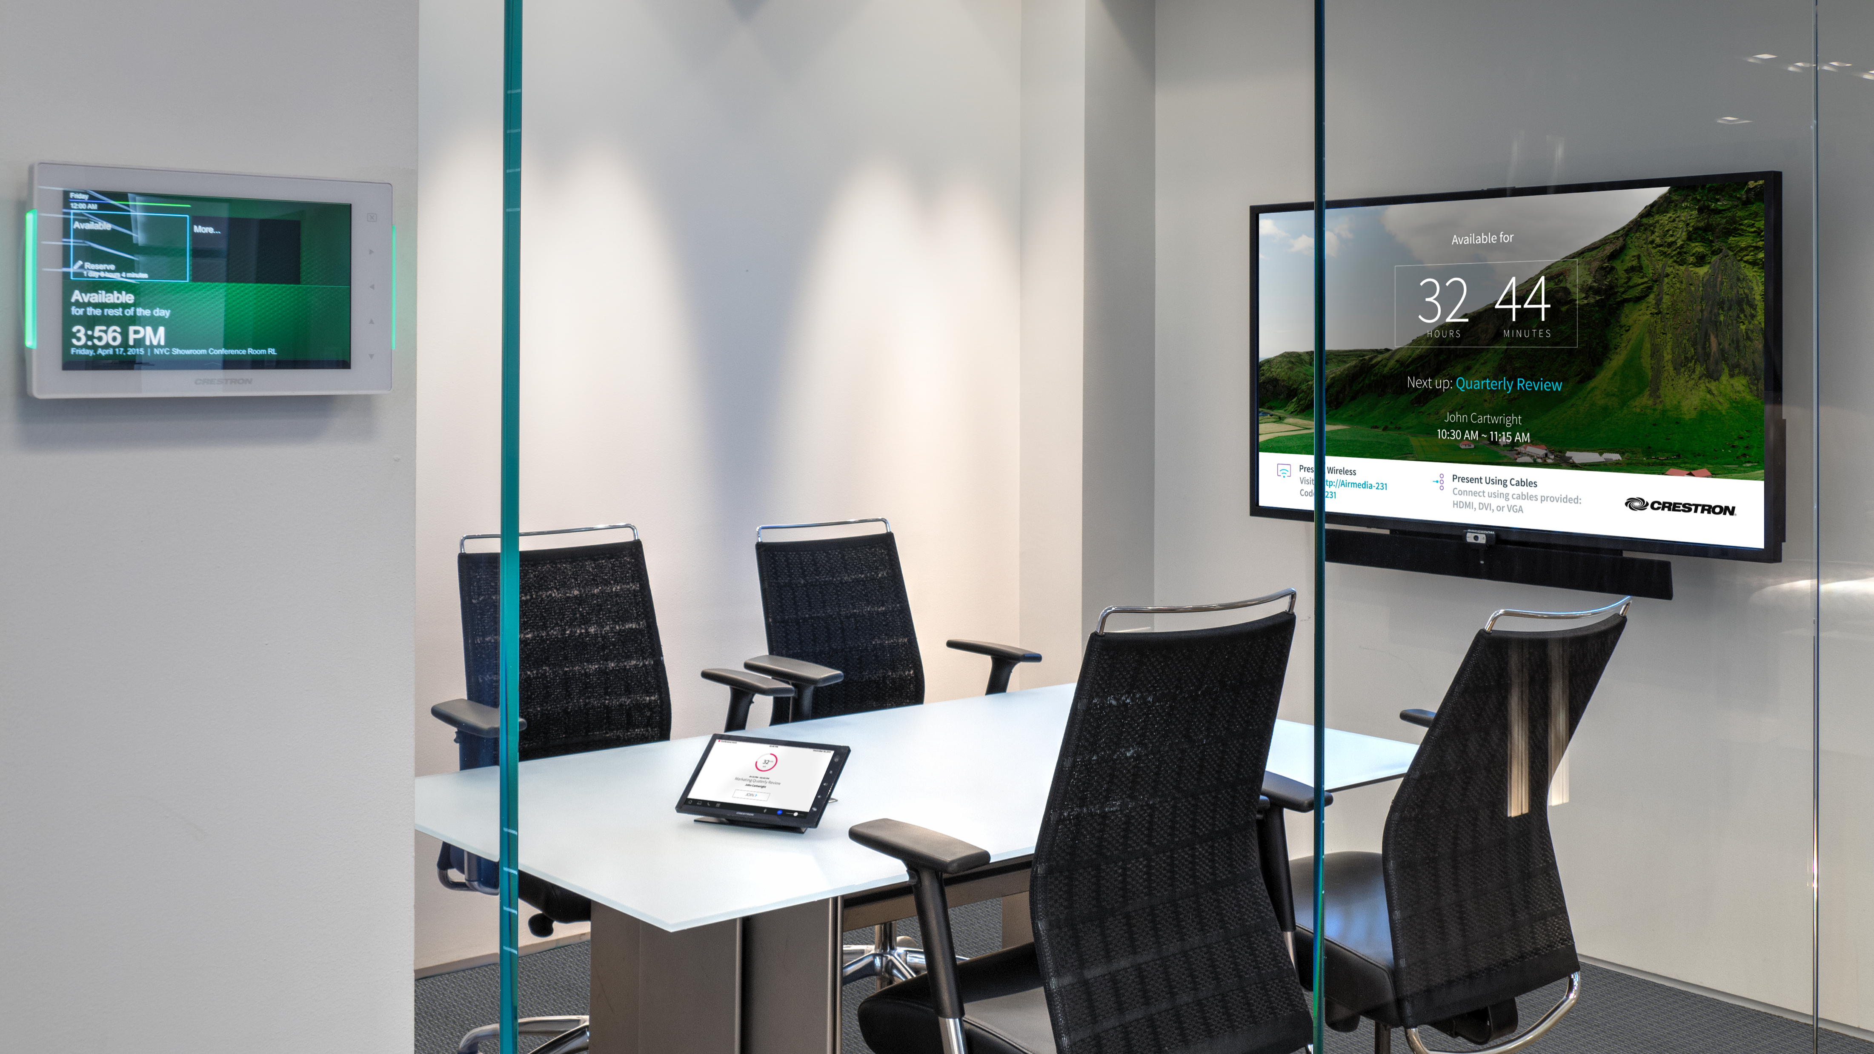
Built on a Hardware Platform
The future of meeting spaces
Consistent experience
Scalable, repeatable
  Boardroom
  Conference rooms
  Huddle spaces
  Training rooms
.AV Framework™ operating system
  Plug-and-play
  No programming required
Notes:
PinPoint is a game changed and an important part of the conversation, but let’s look at some important elements of the meeting room that can continue to change the workplace.

Slide 16
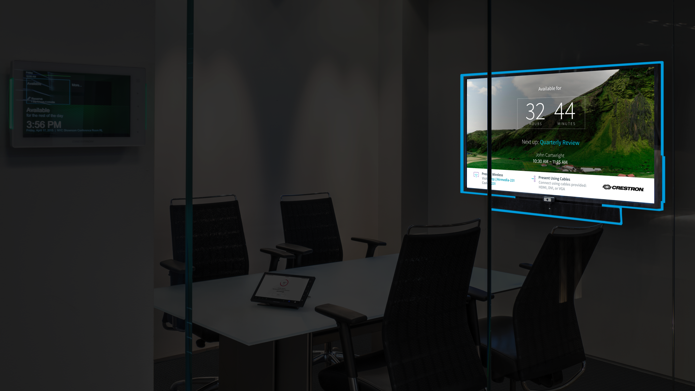
Built on a Hardware Platform
Notes:
Inspired by leading edge companies like Coke, many huddle spaces and meeting rooms have an open concept. The displays can play a big part in changing the entire feeling of the workplace, so why not use that to our advantage? The new meeting room uses the display as “digital signage” for productivity - Imagine being able to glance into a room and know the schedule for the room, or presenting Airmedia connectivity information for visitors along with general room usage guidance in a great looking format where they can’t miss it? The OSD truly brings the workplace to life, and let’s face it most all companies want that “cool factor” today – this brings it big.

Slide 17
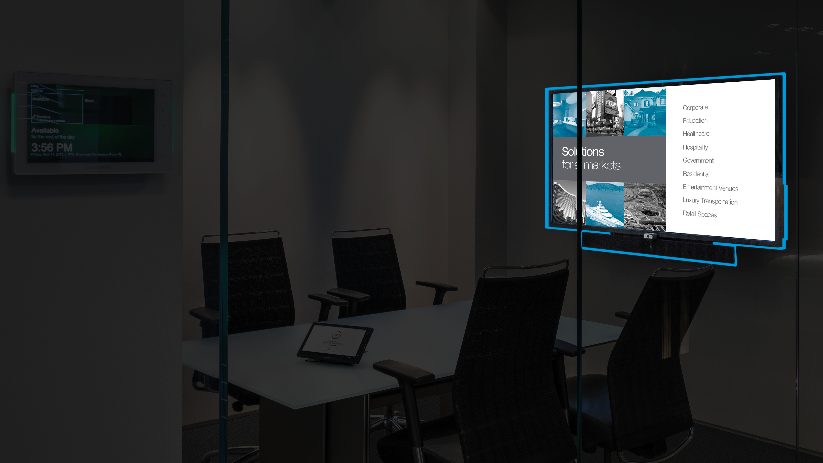
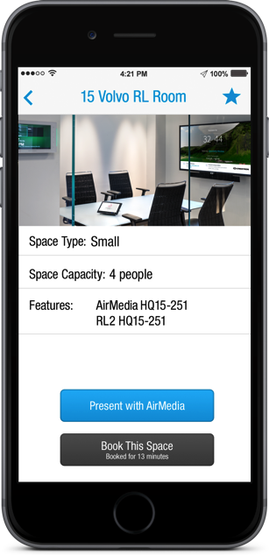
Built on a Hardware Platform
Notes:
The demand for BYOD continues to increase, so connectivity with AirMedia has become a standard. It’s the only mobile device solution on the market with Enterprise management and security built in, and more exciting features are on the way.

Slide 18
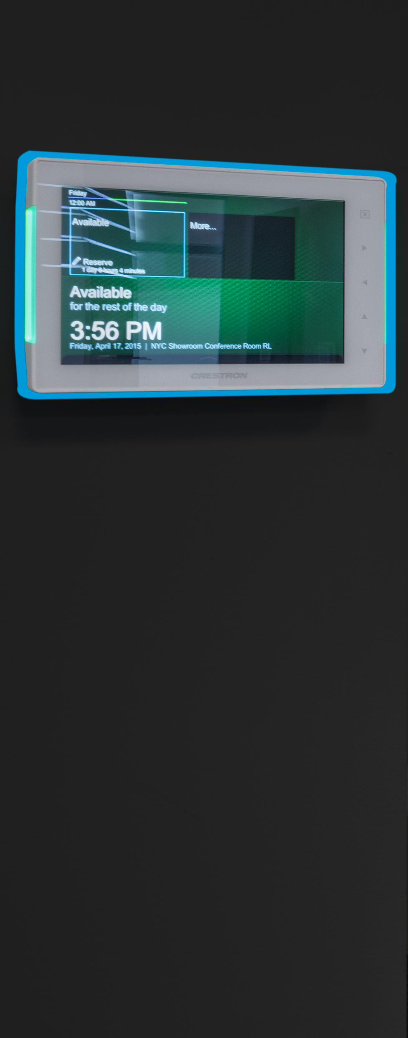
Built on a Hardware Platform
Notes:
Let’s not forget about HDMI and VGA connectivity. There is still a high value for organizations to have true bit for bit, uncompressed, zero latency, 4k HD video on the display with DM

Slide 19
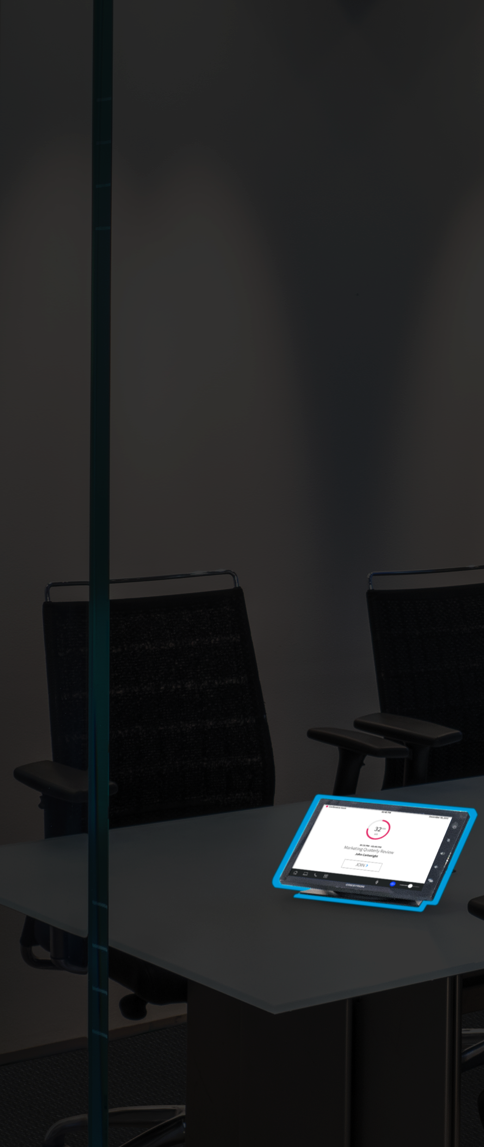
Built on a Hardware Platform
Notes:
Let’s not forget about HDMI and VGA connectivity. There is still a high value for organizations to have true bit for bit, uncompressed, zero latency, 4k HD video on the display with DM

Slide 20

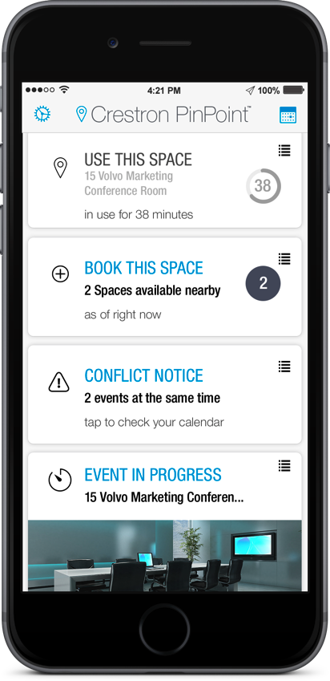






All brand names, product names, and trademarks are the property of their respective owners. Certain trademarks, registered trademarks, and trade names may be used in this document to refer to either the entities claiming the marks and names or their products. Crestron disclaims any proprietary interest in the marks and names of others. Crestron is not responsible for errors in typography or photography. ©2016 Crestron Electronics, Inc.

