Slide 2
Content drives everything we do – at work, at school, and at play. Distributing it is what DM NVX® AV-over-IP technology does for every type of organization – flawlessly and securely.

Slide 3
DM NVX AV-over-IP technology
There’s no challenge a DM NVX solution can’t meet, no type of content it can’t distribute – across campuses, throughout offices, or around the world.

Slide 4
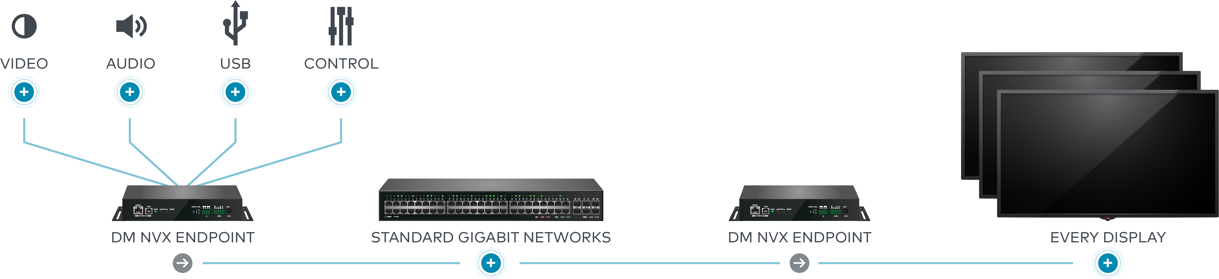
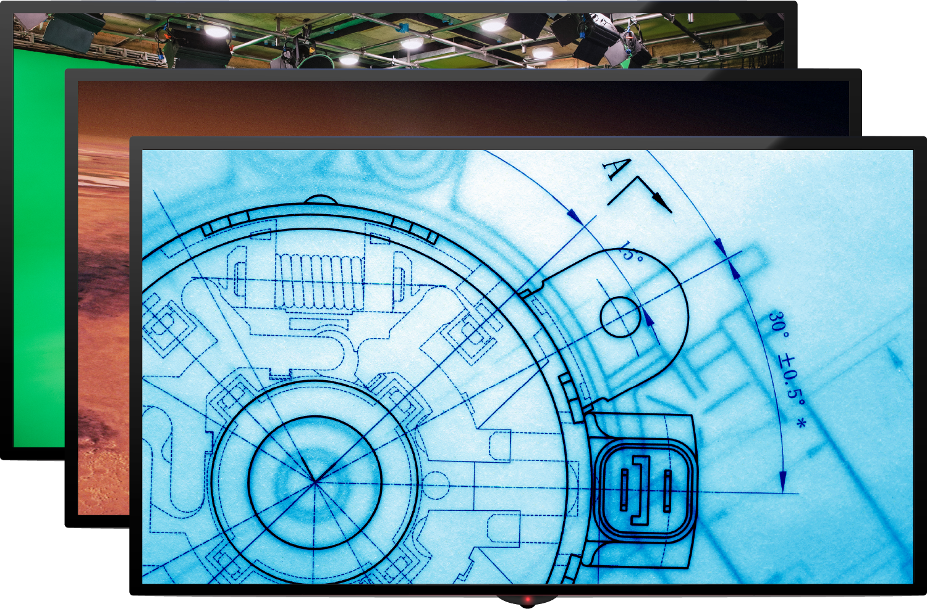
DM NVX
Your standards for image quality, latency, and security.
All meet on one platform.
      Any network
      Any type of content
      Multilayer technology combines
      signals onto one platform
      Greater flexibility
      Highly scalable

Slide 5
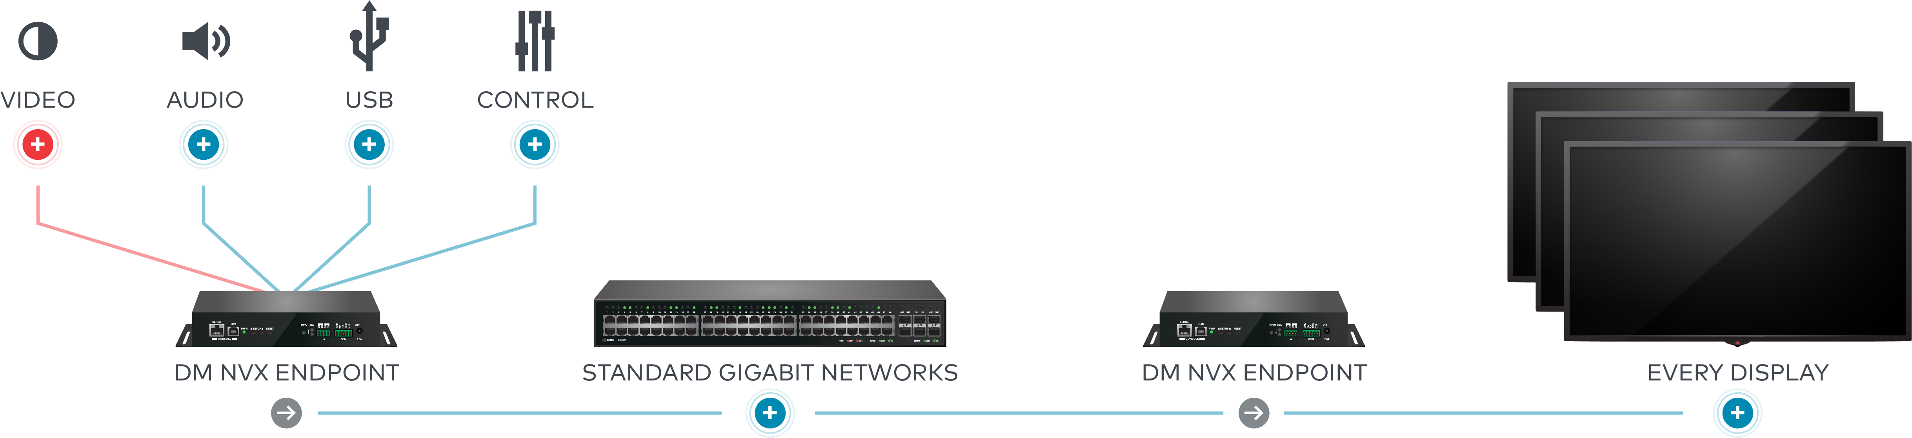
Every format. Every type of content.
Video
      Formats: 480i / 720p / 1080i / 1080p / 4K 4:2:0 /
      4K 4:4:4 / HDR10+ / Dolby Vision®
      Routing: Any signal on the network to any endpoint
      Inputs: HDMI® or network video stream
      Outputs: HDMI or network video stream
      Video wall processing: Supports 8x8
      Route independently from audio
      Image freeze

Slide 6

Every format. Every type of content.
Audio
      Routing: Any signal on the network to any endpoint
      or combine audio and video from different sources
      Downmixing: 363 models includes built-in DSP
      Formats: Digital HDMI and Stereo 2-channel /
      AES67 / Dante® / Dolby Digital® / Dolby Digital EX /
      Dolby Digital Plus / Dolby® TrueHD / Dolby Atmos® /
      DTS® / DTS-ES / DTS 96/24 / DTS-HD High Res /
      DTS-HD Master Audio™ / LPCM up to 8 channels

Slide 7
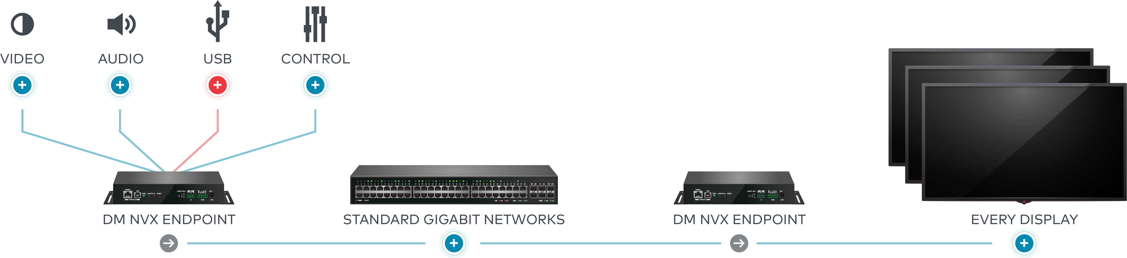
Every format. Every type of content.
USB
      Bi-directional: Route in either direction, regardless
      of if the unit is in transmitter or receiver mode.
      USB-EXT-DM: Signals can be routed between
      DM NVX and USB-EXT-DM units over the network.
      Full USB 2.0 support: Mouse / Keyboards /
      Cameras / ID readers / PCs / Printers /
      Thumb drives / Hard drives / Video game controllers
      KVM signal extension and routing
      on 351, 360, and 363 models
      Any signal on the network to any endpoint

Slide 8
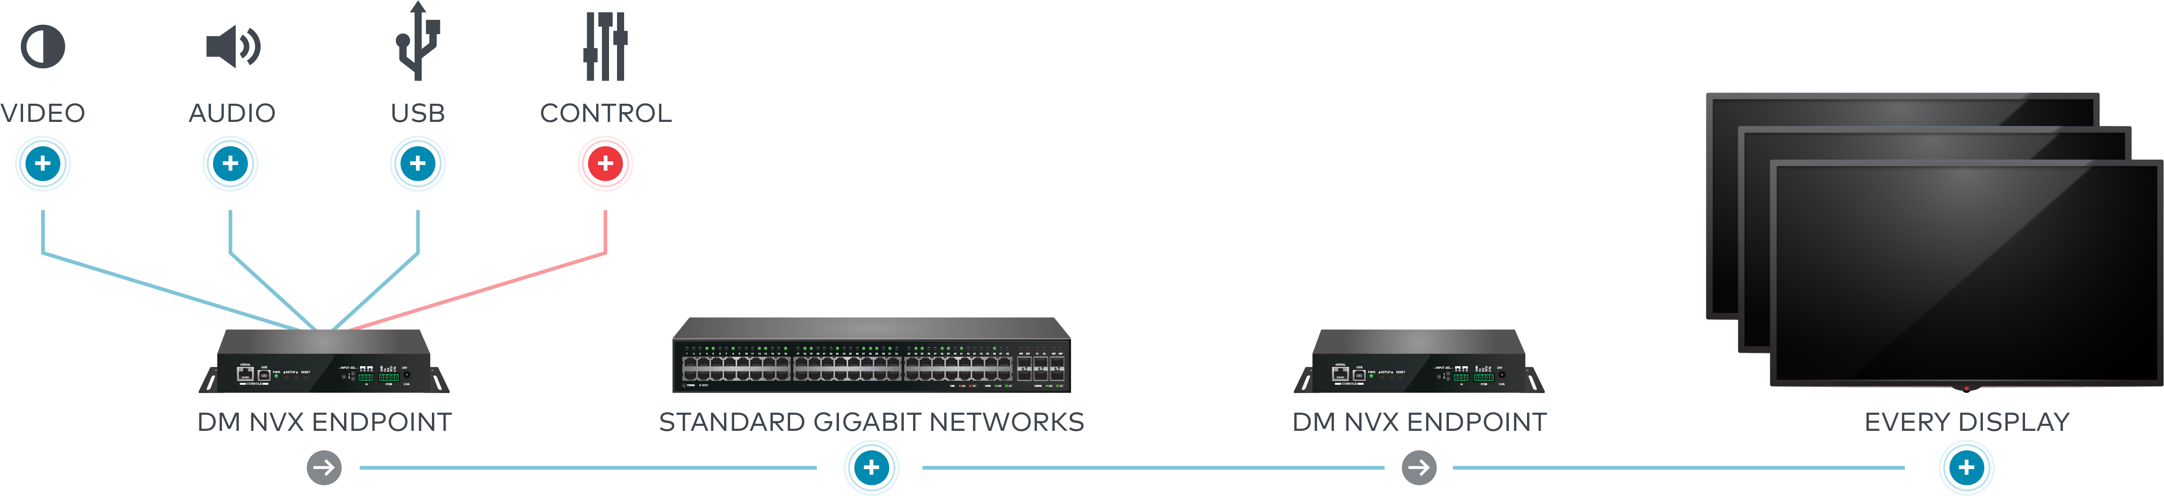
Every format. Every type of content.
Control
      IP: Second RJ45 port provides control signals
      to local devices
      IR and RS-232: Device acts as a gateway for
      control of common displays and other devices
      CEC: Built-in CEC allows display control via HDMI
      Automatic display control
      Simplified routing: Independently route video,
      audio, and USB

Slide 9






Every picture perfect. Every time.
First gen image
JPEG2000
Pixel Perfect Processing Image
Pixel Perfect Processing
The only AV-over-IP solution that delivers flawless video and Pixel Perfect Processing images.
    Pixel Perfect Processing only available with DM NVX; developed in conjunction with Intel and intoPIX
    Builds on the fundamentals
    and efficiencies of JPEG 2000
    Adds to DM NVX reputation for flawless video
    Delivers the same quality as the direct source
    Imperceivably perfect; see the finest detail in the densest image

Slide 10
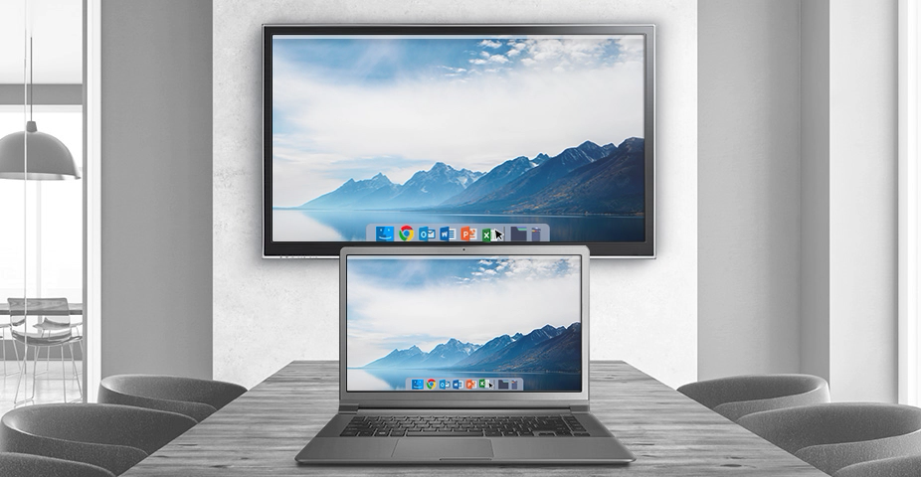
What latency?
    Zero latency
    Experience imperceivably responsive technology
    Meets Human Interface Device standard
      Ensures synchronized camera and audio
      Mouse and keyboard move with you
    Feels like an extension of you
    Works in real-time

Slide 11

Your network. Your protocols. Your standards.
    Works with every network
        Designed as 1Gb solution on Cat5E cable
    Partners with best in breed technology
        Microsoft IoT Partner of the Year
        Intel
        IntoPIX
    Industry formats for interoperability
    All built to the strictest guidelines to ensure the greatest security

Slide 12

Every network
    Network flexibility
        The 1 Gigabit solution that works with any network, any application, any design
    Layer 3 compatibility
        DM NVX is capable of transporting data to different sub networks
    Flexible bit rate options
        Adjustment bit rate based on the resolution of the source being routed
        Use network resources efficiently where full 4K60 4:4:4, HDR is not required or bandwidth is limited
    Quality of service standard protocol
    Stream port selection
        Route audio, video, and USB control on separate physical networks

Slide 13









The standards you use. The interoperability you want.
DM NVX works with industry standards and systems you have, so you can achieve whatever you want.
Standards
Extend DM NVX…
Broad range of video and audio standards.
Into the world of the most popular displays with a plug-and-play solution: DM-NVX-D80 IoAV decoder
With existing DigitalMedia™ and HDBaseT® systems with the DM-NVX-E760

Slide 14
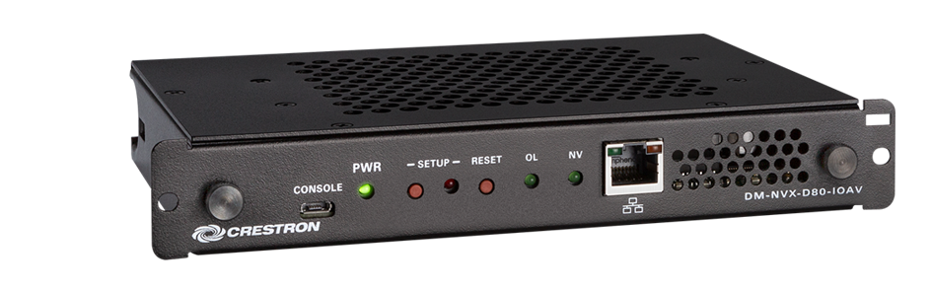







The standards you use. The interoperability you want.
Native DM NVX IoAV decoder endpoint
Extend into the world of the most popular displays with plug-and-play solution – eliminate cables and mounting
Compatible with Intel® Open Pluggable Specification (OPS) for seamless integration with OPS-supported displays
Deliver audio and video, 4K60, 4:4:4, HDR across any size network
Partners

Slide 15
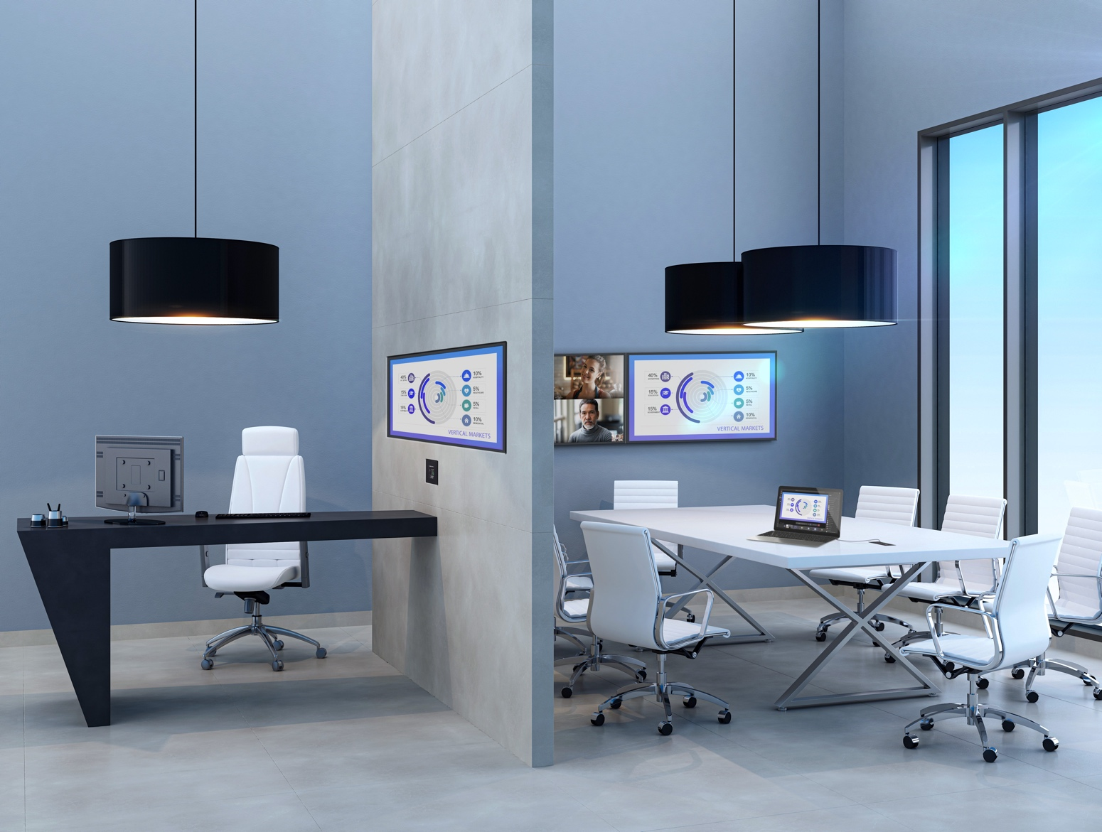
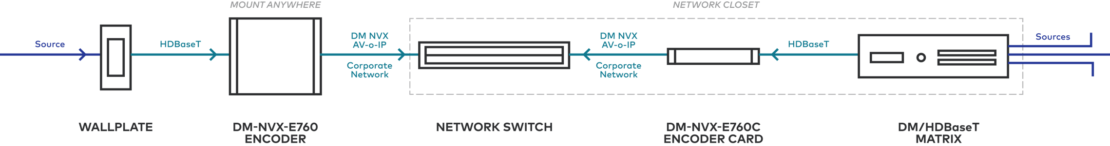
The standards you use.
The interoperability you want.
Unify HDBaseT and AV-over-IP
  The only 4K60 4:4:4 HDbaseT to AV-over-IP solution on the market:
    Endpoint that bridges DM and HDBaseT outputs to a
    DM NVX network
      Fully interoperable with current DM NVX ecosystem
      Native integration of Crestron DM, DMPS, and DM Lite® systems with DM NVX
    Offers ability to utilize 1-gang wall plate
      4K60 4:4:4 support when pairing with a DM-TX-4KZ-100-C-1G
      4K60 4:2:0 when pairing with a HD-TX-101-C-1G-E
    Native support for audio-over-IP to integrate with DM NVX and 3rd party systems
Notes:
It is an ideal solution for applications that require integrating AV-over-IP into existing HDBaseT systems or expanding an existing room system for broader distribution. The DM-NVX-E760 offers full DM NVX product compatibility and support for Crestron DigitalMedia including DM matrix switchers, all-in-one DMPS systems, and DM Lite®. It also makes it easy to add wall plate transmitters to any installation, just choose the right DM or DM Lite wall plate and connect to the DM-NVX-E760

Slide 16

Every network secured
    AES Encryption: Ensures secure audio and video transmission
    802.1x Authentication: Ensures that every device on the network is explicitly authorized
    Active Directory®: Centralized credential management
    PKI Authentication: Authenticates specific devices and enables secure key exchanges
    SSH Network Protocol: Encrypts and protects command line communications

Slide 17
Every network secured
    HTTPS: Encrypts the data sent between your web browser and the DM NVX web configuration interface
    Secure CIP: Ensures secured communications between Crestron control systems and DM NVX devices
    SFTP: Secure File Transfer Protocol
    TLS: End-to-end communications security over networks

Slide 18
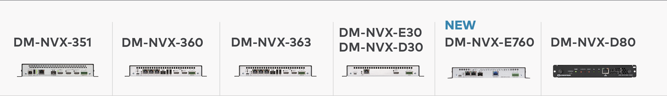
Every option. Every need met. Every expectation exceeded.
    Ecosystem of products work as one
    Choose the features you need without sacrificing performance or interoperability
    Everything you need, nothing you don’t
4K60, 4:4:4
HDR
PoE+
1 HDMI output
Full surround Audio
No breakaway audio
RS232, IR (endpoint only)
CEC
4K60, 4:4:4
HDR+ and Dolby Vision
PoE+
1 HDMI input
1 HDMI output w/ 4K60 4:4:4 scaler
2 USB-A for HID
USB-2.0 Separation
USB 2.0 and KVM routing
CEC
4K60, 4:4:4, HDR+ and
Dolby Vision, PoE+
1 HDMI input, 1 HDMI output
w/ 4K60 4:4:4 scaler
Full surround Audio
Breakaway audio,
Built in DSP for Downmix
Dante Support
2 USB-A for HID
USB-2.0 Separation
USB 2.0 and KVM routing
RS232, IR (endpoint only)
CEC
4K60, 4:4:4
HDR
PoE+ (endpoint only)
1 HDMI® input (E30)
1 HDMI output (D30)
Full surround audio
RS232, IR (endpoint only)
CEC
Now, easily deploy 1-gang wall plate solutions and bridge HDBaseT systems with AV-over-IP.
4K60 4:4:4
HDR Network AV OPS Decoder
OPS (Open Pluggable Specification) Support
USB 2.0 Routing
CEC

Slide 19
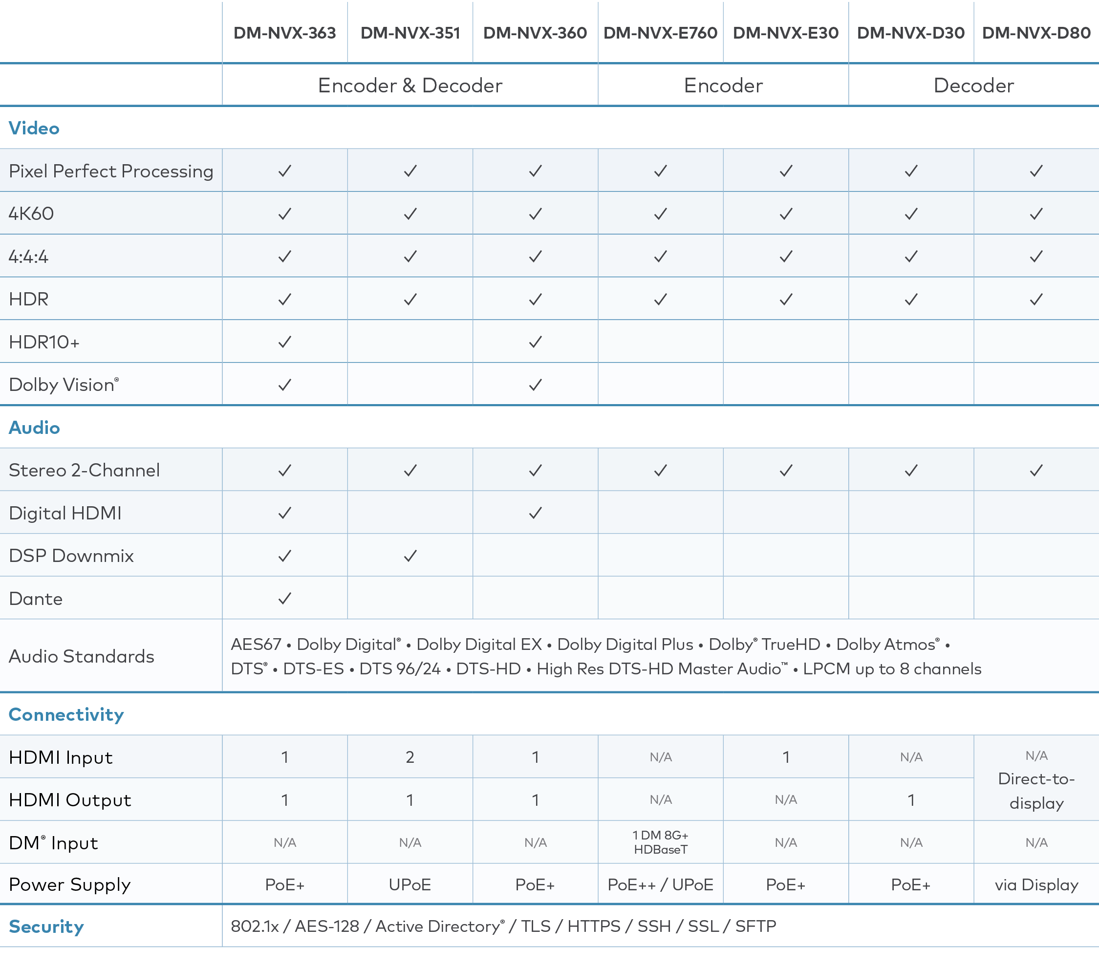
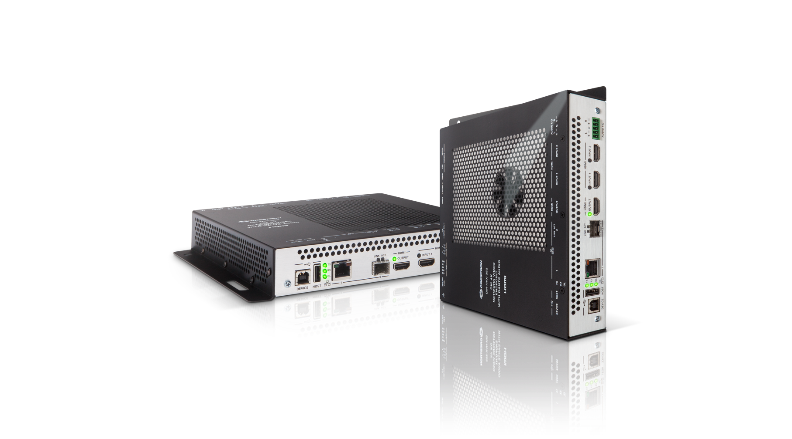
Every option. Every need met. Every expectation exceeded.

Slide 20

A single, simple management system
    DM NVX Director™ virtual switching appliance is mission control
    Configure, monitor, and manage every DM NVX endpoint network-wide
    Real-time signal routing and control
    Edge routing and distribution
    Manage at a campus level and create logical groups (domains) for your DM NVX platform
      Break them into rooms or groups–whatever suits your business needs.
    Visualize your AV network

Slide 21
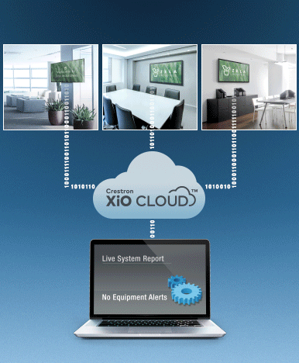
Take management one step further
Crestron XiO Cloud® provisioning
and management
    Increase efficiency
    Manage and update firmware
        Remote
        Individually or all at once
    Monitor device status anywhere
    Resolve events remotely to improve device uptime

Slide 22
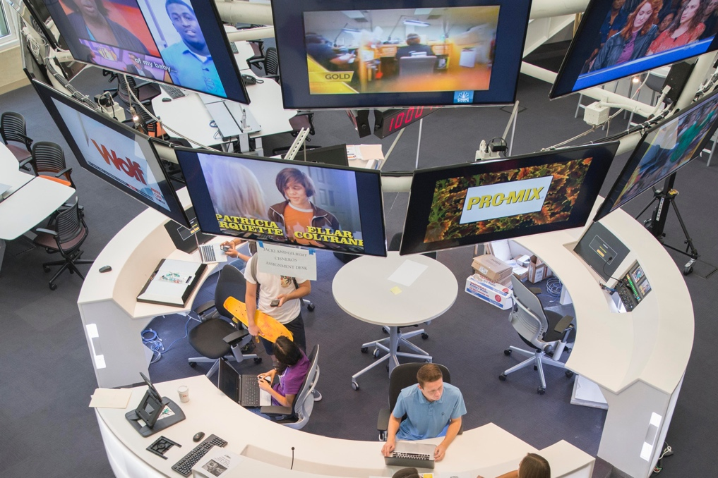
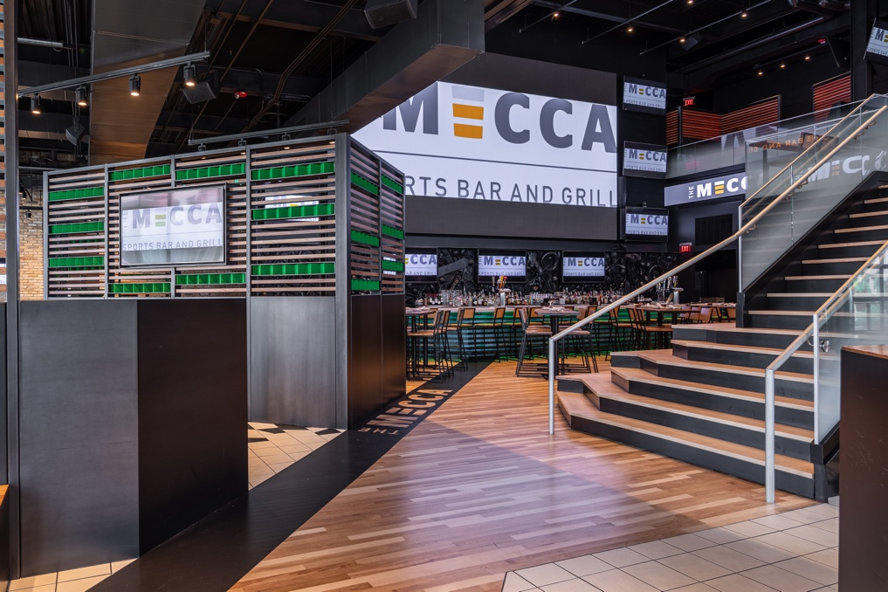
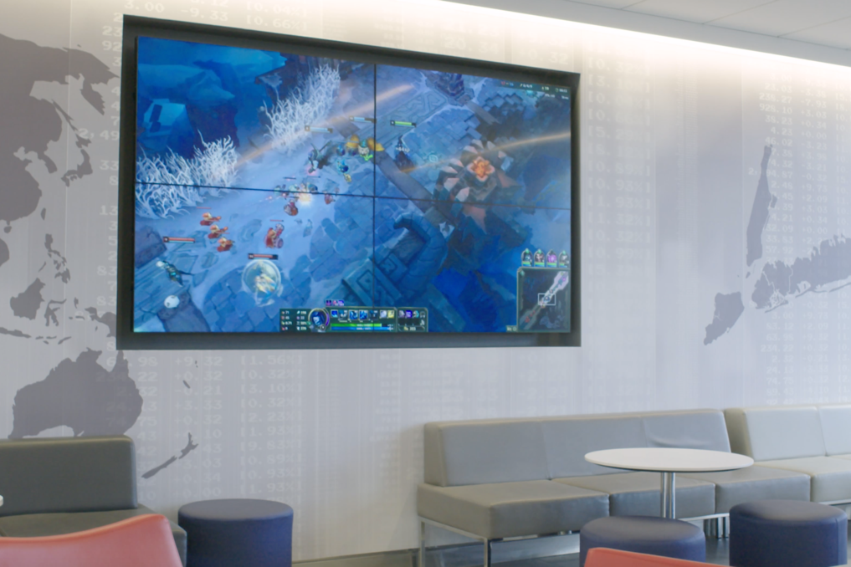
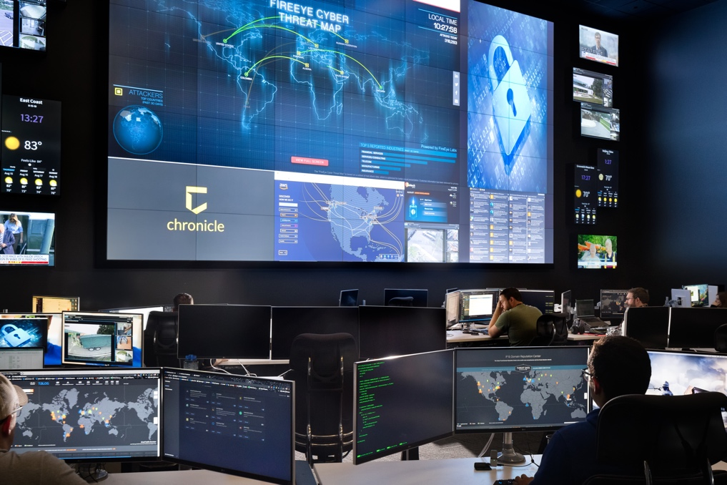
Every application
DM NVX solves video distribution needs across enterprise, education, government, and more.
The University of Southern California
MECCA
Sports Bar and Grill
St. John’s
University
Fishtech
Group

Slide 23
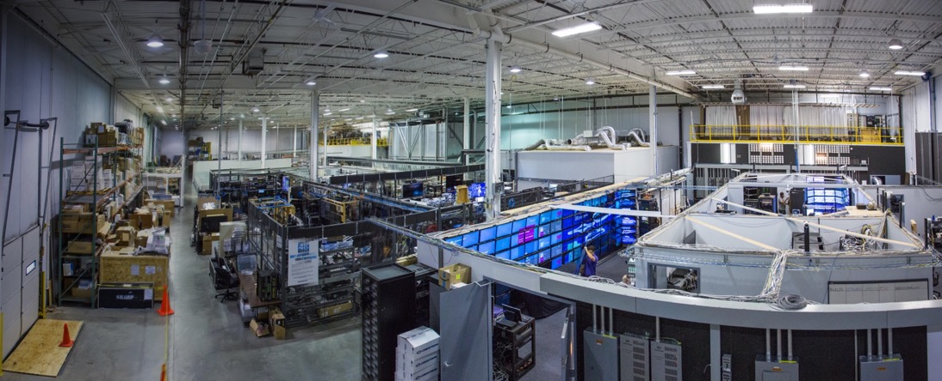
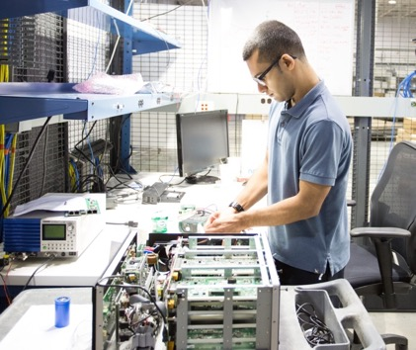
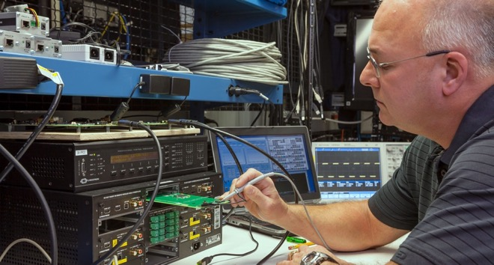
Every product tested
    Performance Labs: Simulate real-life applications involving hundreds of devices to ensure real-world performance
    HALT Lab: Highly Accelerated Life Test stresses individual components which helps engineers optimize designs for long life
    Heat Chamber: Confidently mount units behind a display or in an enclosure
    RF Chamber: Ensures electromagnetic interference has no impact on performance

Slide 24
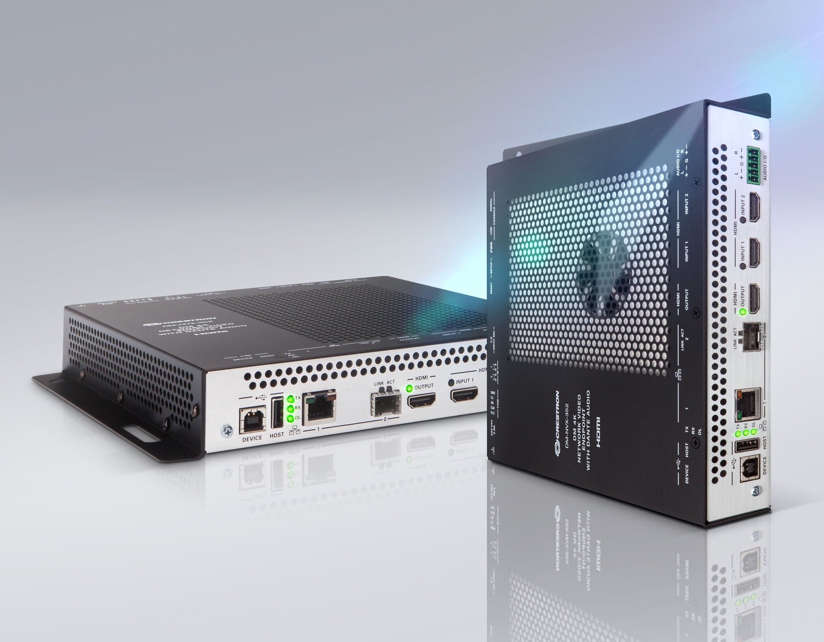
Simple. Scalable. Flexible. Affordable. Secure.
    One system that does it all
    Works with any network
    Mix and match to your needs for performance
    Infinitely scalable
    IT-friendly

Slide 25

Simple. Scalable. Flexible. Affordable. Secure.
    24/7 True Blue support
    Certified switch configurations
    Online chat messaging services
    Free advanced technical support
    Sales support for: Design / Recommendations / Quotes / Network Switch Configuration Guides

Slide 26
Learn more at crestron.com/NVX

